Slide 1
Justin Ko
1983.06.22

Slide 2
Timeline
2011
2013
2019
2022
2023
CoreRiver
DB Hitek
Imagination Technologies
SemiFive
MetaEncore
Newbie
Firmware
Security
C / C++ / Assembly
Touch screen
Firmware
Android app
WLB
C# / Object C
English
Linux / Kernel
Open-source
GPU
Driver
Samsung & LG
Hard Work
Python / Shell / OpenGL / GLSL / Vulkan / OpenCL / OMX /
Team
DevOps
SoC Design Verification
Scala / Chisel / Ruby
Together, We turn Ambition into Action (CITADEL)

Slide 3
Satisfaction Rate
100
80%
Result
우리는 모두 함께 야망을 행동으로 바꾼다
90
80
50%
Teamwork
70
Leader, Goal, Dream
60
50
20%
Hard work
40
여긴 어디? 나는 누구? 내 가족은?
30
20
40%
Work-Life Balance
아무것도 안하면 아무일도 일어나지 않는다
10
80%
Newbie
열정, 열정, 열정

Slide 4
PROS AND CONS
Contra
길치, 방향치, 몸치, Chicken Scratch
Game, 승부욕
Contra
Pros
Pros
새로움, 신문물, 효율성
공유, 공짜, 유도리

Slide 5
Buy Time, Share Time

Slide 6
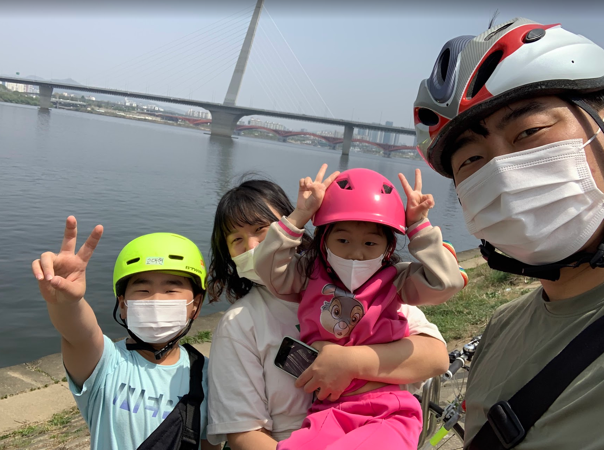
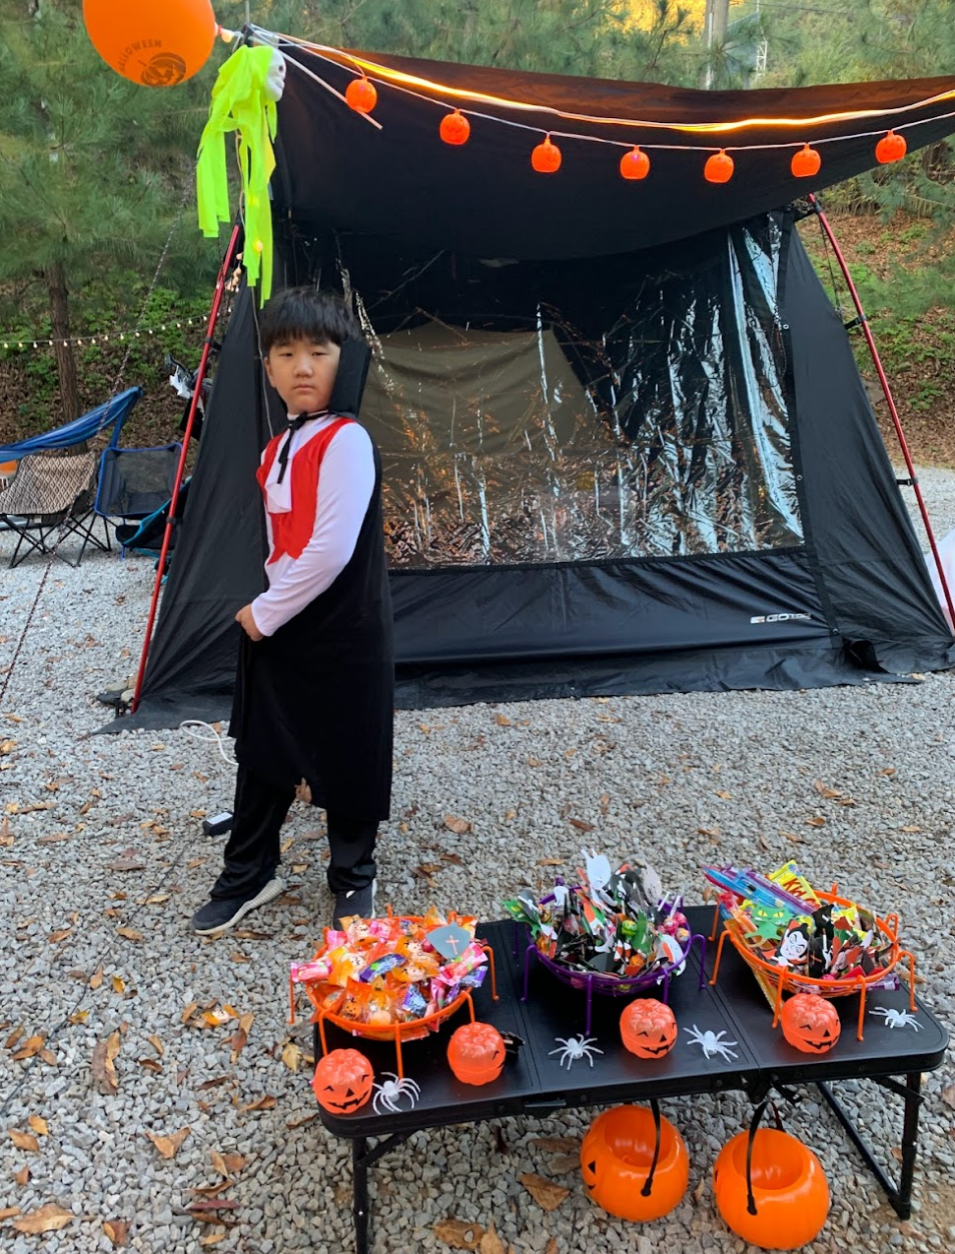
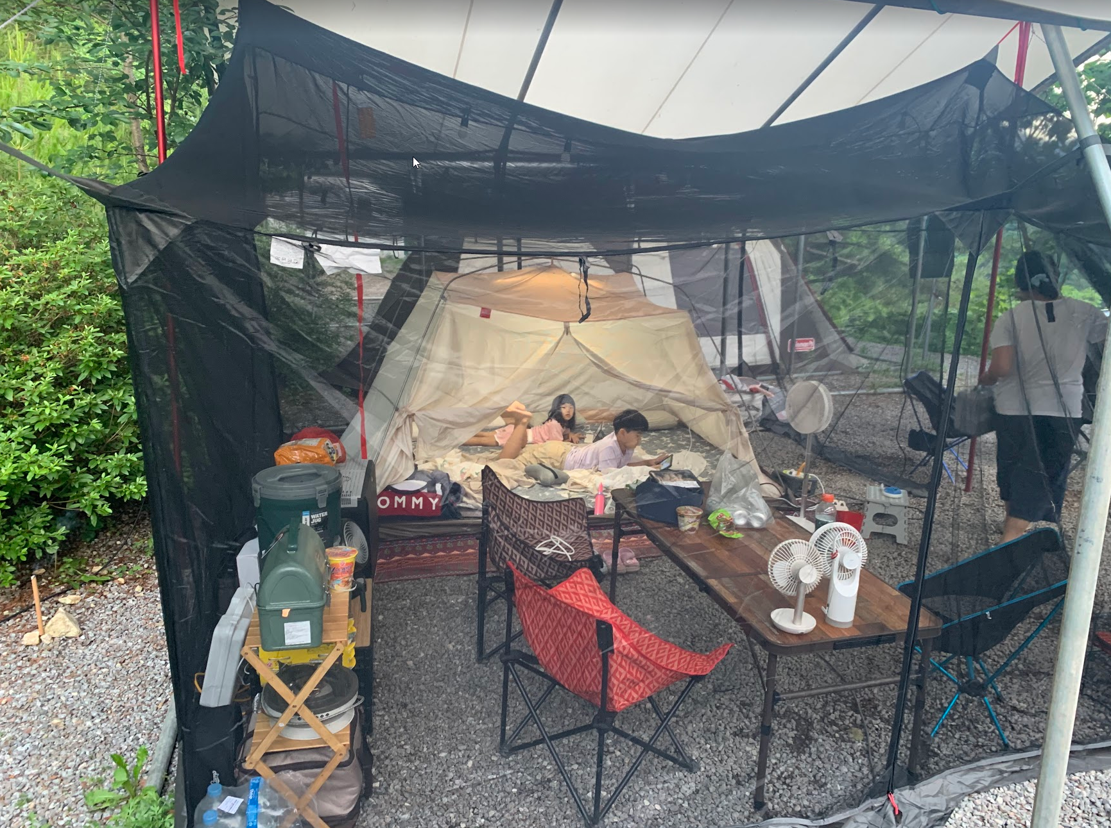
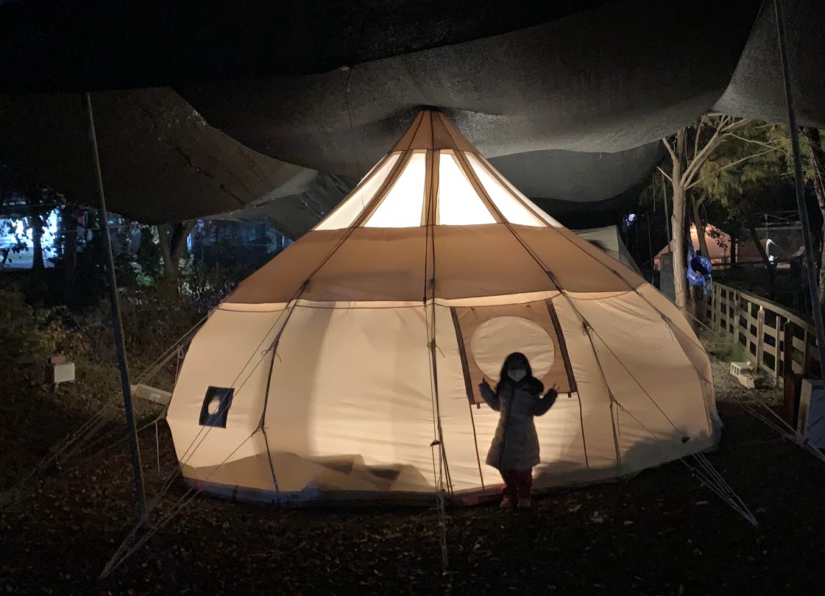
4 Seasons
Spring
Autumn
Summer
Winter

Slide 7
THANK YOU

